Slide 1






HEALTHCARE PROFESSIONALS
AS CLIMATE & HEALTH COMMUNICATORS
HOPE ROBINSON, CLIMATE COMMUNICATIONS OFFICER
HCWH EUROPE
EUROPEAN HEALTHCARE CLIMATE SUMMIT
10 OCTOBER 2024
Notes:
Good afternoon, everyone. I'm Hope, and I'm very happy to be here with you today to speak about how healthcare professionals can become powerful climate and health communicators, able to engage with their organisation, with public and with policymakers on the urgent need for climate action through its link to health.
I want to start by saying that effective communication is at the heart of all progress - every initiative, policy change, or community effort begins with discussion and shared understanding - which makes the role of skilled communicators absolutely vital in driving meaningful progress on climate issues. So, thanks for being here with me to talk about it.

Slide 2



TODAY’S AGENDA
  Introduction: Why healthcare professionals?
  The core principles of discussing climate change & health
  Our resources to help you grow your communication skills & confidence
  Example: Countering a common climate myth head-on
Notes:
So my presentation has four parts today. To begin, I'll discuss why healthcare professionals are uniquely positioned to communicate impactfully about climate change.
Then, I'll outline the core principles for discussing climate change and health to advocate for climate action.
Third, we'll explore how to get started on this journey with HCWH Europe’s communication guides for healthcare professionals, presented in a suggested order from the most beginner-friendly resources to more advanced ones that will help you further develop your skills.
Finally, we'll take a brief look at an example from one of the guides, that focuses on responding to common misconceptions about climate change in Europe, for everyone to leave with a response in mind should they ever encounter this myth.
Let’s get to it.

Slide 3



INTRODUCTION: WHY HEALTHCARE PROFESSIONALS?
“As trusted voices in communities worldwide, healthcare professionals and organisations have significant potential to influence the social and policy landscape in support of decarbonisation and climate resilience.”
“Health framing of the climate emergency has proven effective in inspiring populations to take action.”
Dasandi et al., 2022
Positive, global, and health or environment framing bolsters public support for climate policies
Howard et al., 2023,
Learning to treat the climate emergency together: social tipping interventions by the health community
Notes:
First, I feel it’s important to set the scene by considering WHY healthcare professionals are uniquely positioned to be effective at advocating for climate action in general - within and beyond the healthcare sector.
First, as Howard et al wrote, “as trusted voices within communities around the world, health professionals have enormous potential to influence the social and policy landscape in support of decarbonisation and climate resilience”. Health professionals are highly trusted due to their ethical standards, high scientific literacy, expertise, and community involvement, and thus their behaviour and messaging can be influential on those around them or those that they aim to influence.
This trusted position uniquely qualifies health professionals to effectively communicate about climate crisis - particularly by framing it in terms of its health impacts. As my second fact states, research has shown that "health framing of the climate emergency has proven effective in inspiring populations to take action." So, the most ideal channel by which health professionals can catalyse climate action is by highlighting the direct impact of climate change on public health, and linking climate action to the protection or promotion of health.
The combination of health professionals' trusted status and the effectiveness of health framing offers a powerful synergy - and opportunity to communicate in a way that has wide impact, opening minds, creating dialogue, and catalysing action. So, next, let’s talk about the 5 core principles that you can use to seize that opportunity.

Slide 4
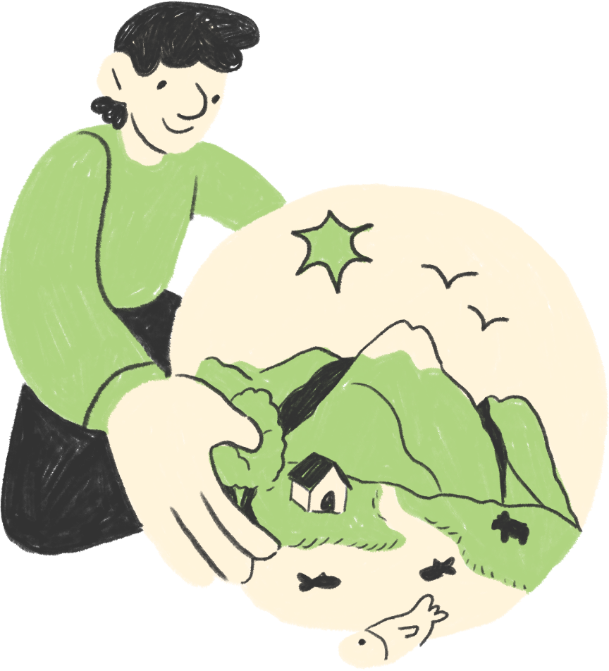
THE CORE PRINCIPLES OF DISCUSSING
CLIMATE CHANGE & HEALTH
(TO ADVOCATE FOR CLIMATE ACTION)
  Climate action is mitigation and adaptation
1
  2
  Focus on local, immediate impacts to make climate change tangible
  3
  Emphasise the co-benefits of climate action
  4
  Leverage credibility and make your message accessible
  5
  Offer hope and highlight success stories
Notes:
1) CLIM ACTION IS BOTH MIT AND RESIL.
Climate action involves both mitigation and adaptation efforts, across society. Mitigation focuses on reducing the carbon footprint of human life, by lowering emissions, improving energy efficiency, and promoting sustainable practices. Adaptation focuses on adjusting our systems to cope with the ongoing and future effects of climate change, such as by implementing new protocols or infrastructure to handle rising temperatures and disease patterns. By advocating for both, we work to create a system that not only minimises harm and stops worsening climate change but is also prepared to protect communities from the evolving risks of a changing climate, which often has immediate health impacts. This holistic approach to climate change doesn’t just mean looking out for future generations - as we should - but also protecting ourselves and our societies now, which can often garner more support.
2. FOCUS ON LOCAL, IMMEDIATE IMPACTS TO MAKE IT TANGIBLE.
You can do this by making climate change a personal and local issue for everyone, through the scientific realities in your local context. For instance, we know that climate change contributes to an increase in extreme weather events, air pollution, and the spread of vector-borne diseases - consider the health impacts experienced by people in your region the most and accentuate that as a reality; Such as rising asthma rates due to air pollution, or injury, death and loss from flash floods or heat domes. This can help people understand climate change as a hard reality rather than a distant, wicked problem.
3. Directly related to the above principle, is EMPHASISE THE CO BENEFITS OF CLIMATE ACTION.
This looks like explaining that actions to mitigate climate change not only reduce emissions but also improve public health. For instance, better air quality leads to fewer respiratory diseases. The same goes for adaptation - everyoen is much better served when their community has reinforced their infrastructure so it won’t fail in the next major storm or heatwave. Many of these actions can also reduce costs long term. This emphasis makes these solutions feel more immediate and beneficial, especially for those who don't yet see climate change as an urgent issue - what if these solutions could just make all of our lives better? Well, they can, and they do.
4. 4 IS USE YOUR CREDIBILITY TO MAKE THE MESSAGE ACCESSIBLE.
So, we’ve established that you don't need to be a climate expert to advocate for climate action—as discussed earlier, healthcare expertise itself lends credibility when using health framing - speaking about the observed health impacts of climate change in your area. Use that credibility and scientific literacy to translate complex concepts into accessible language and avoid technical jargon. Instead of alienating, you’ll make climate change relevant to everyday concerns and more easily understood.
Finally, 5. OFFER HOPE AND HIGHLGIHT SUCCESS STORIES.
Finaly, don't dwell solely on the negative impacts of climate change. This approach can paralyze people with fear and prevent action. Instead, inspire hope through concrete solutions. Showcase real examples of individuals, communities, and healthcare systems successfully addressing and adapting to climate change. Many effective strategies already exist – our challenge is to replicate and scale them globally. Emphasise success stories, like those shared today, and reframe climate action as an opportunity to enhance both human and planetary health across multiple dimensions - so people know that by taking action, we can create a healthier, more resilient world for all.

Slide 5



HCWH EUROPE’S
COMMUNICATIONS
GUIDES
FOR HEALTHCARE PROFESSIONALS
Notes:
Now let’s get to know what resources we have at HCWH Europe to support healthcare professionals to gain and hone communications skills.

Slide 6
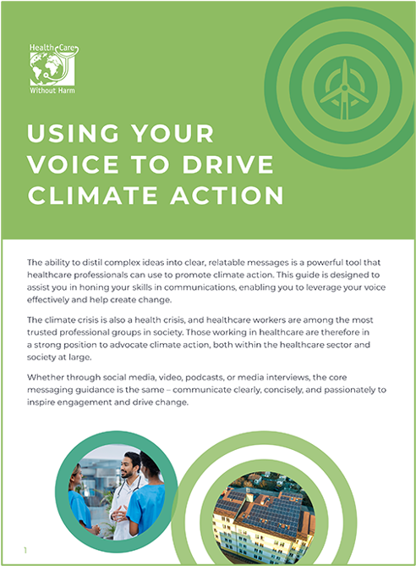
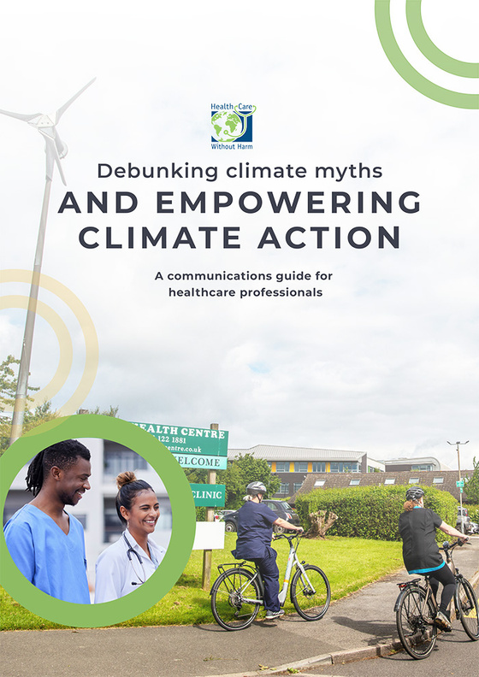

GETTING STARTED
A ‘get-started’ guide to finding and using your voice to make strong points and communicate confidently
A guide to
countering common misconceptions
head-on
Notes:
In "Using your voice to drive CA," we offer a broad getting-started guide to finding and using your voice: from figuring out your communication style , identifying your intended audience ,to using social media, and preparing clear and to-the-point messaging.
In "Debunking climate myths and empowering climate action", we have done some message-cratfing for you: we distil some often complex ideas into clear, relatable messages that will help you to confront and challenge common myths or misconceptions about climate action, and expose how they’re false - educating others in an empowering way.

Slide 7
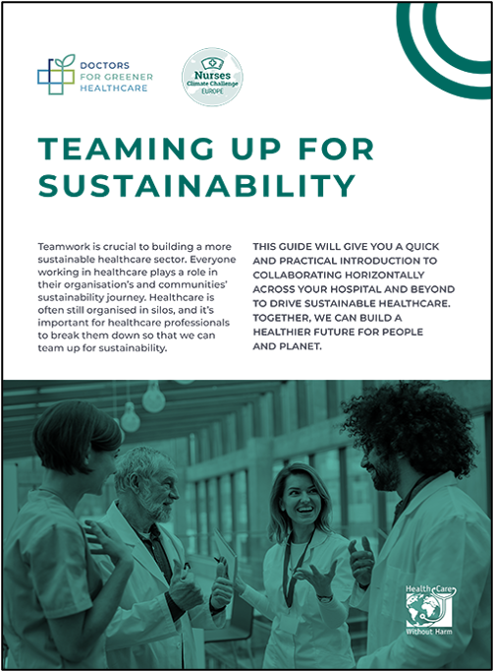
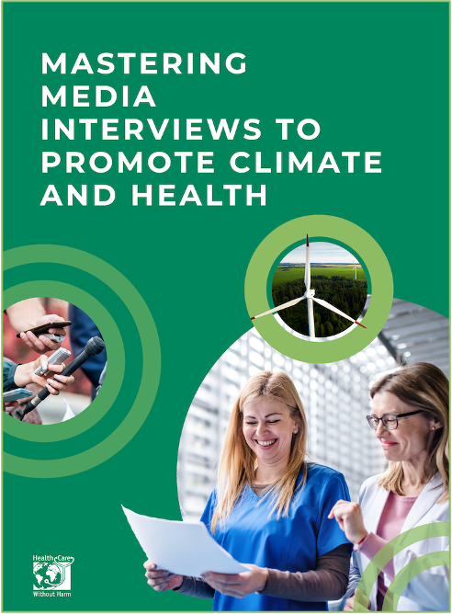

TAKING THE NEXT STEPS
A guide to collaborating among colleagues to advocate for climate action
A look into how the media works & advice on giving interviews and tackling difficult questions
Notes:
Our next two guides provide slightly more advanced and in-depth strategies to help you further develop your advocacy and communication skills.
In "Teaming Up", we offer practical steps you can take to collaborate horizontally across your organisation to create change, particularly as healthcare remains a very siloed sector. A great guide for when you’re ready to advocate directly, and know there is strength in numbers.
In "MMI", we pull the curtain back on how media and journalism operates and how you can navigate that and prepare to give great, informative interviews - informing the public and calling for climate action.
All of these guides are available in our virtual booth on Hubilo for quick access, except "Teaming up," which is available only to members of our GGHH network or Healthcare professional networks, which are free to join and absolutely worth it.

Slide 8

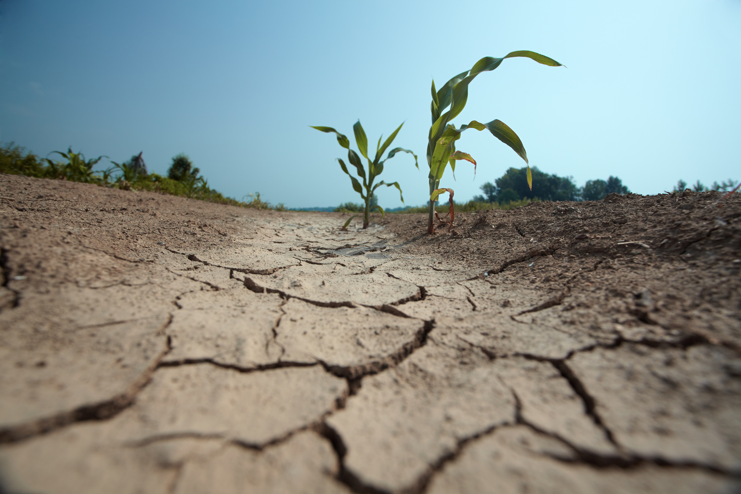
DEBUNKING A CLIMATE MYTH
Notes:
This brings us to the final little bonus section - sharing an excerpt from our most recently published guide, Debunking climate myths and empowering climate action.

Slide 9
MYTH:
“Climate change does not affect us in Europe.”
REALITY:
Europe is heating up faster than any other continent in the world. Extreme weather events, such as heatwaves, storms, and flooding, are occurring more often and with more severity, threatening health, agriculture, buildings, and biodiversity, and causing injury, illness, and death across societies.
At the same time, Europe contributes significantly to climate change. Countries in the European Union produced over 17% of cumulative carbon dioxide emissions globally since the start of the Industrial Revolution. It is estimated that the EU makes up 12% of the global healthcare climate footprint, surpassed only by China and the USA.
We are part of the problem - and must be part of the solution.
From Debunking climate myths & empowering climate action, HCWH Europe, 2024 - References within
Notes:
This misconception is more common than you’d think - the idea that “Climate change does not affect us in Europe.”
In fact, Europe is heating up faster than any other continent in the world. Extreme weather events, such as heatwaves, storms, and flooding, are occurring more often and with more severity, threatening health, agriculture, buildings, and biodiversity, and causing injury, illness, and death across societies. At the same time, Europe contributes significantly to climate change. Countries in the European Union produced over 17% of cumulative carbon dioxide emissions globally since the start of the Industrial Revolution over 200 years ago. We are part of the problem - and thus must be part of the solution.

Slide 10



"Collectively, the actions of health-care workers can shift practice, finance, and power in ways that can transform the public narrative, influence investment [and] catalyse the rapid decarbonisation needed to protect health and health systems."
— Howard et al., 2023, Learning to treat the climate emergency together: social tipping interventions by the health community
Notes:
To finish, I'm sharing a quote that I hope reflects a key takeaway of this presentation - reminding all health professionals of the critical role each of you can play, whether a nurse, doctor, administrator, or support staff, in shifting practice, finance, and power by using your voices and taking action.
I encourage you all to read this article on how the health community can maximise its influence on driving the transition to net zero and climate resilient societies, and check out our comms guides to get some practical tips right away. You can check out my slides after the fact in our virtual booth for all references and information.

Slide 11



Thanks for listening!
Contact me:
hrobinson@hcwh.org
Co-funded by the EU. HCWH Europe is solely responsible for this content and related materials. The views expressed do not necessarily reflect the official views of the EU or CINEA, who cannot be held responsible for them.
Notes:
Finally, many thanks for being here today, and for each effort you make to effect change. I hope you enjoy the rest of the Summit!

Slide 12
BONUS MYTH-BUSTING
MYTH:
“Healthcare doesn’t need to take climate action when other sectors haven’t.”
REALITY:
Despite being a sector whose mission is to heal, the healthcare sector has a significant climate footprint and makes a major contribution to the climate crisis. Healthcare’s climate footprint is equivalent to 4.6% of global net emissions. As the climate crisis is a global health emergency, it is crucial to take widespread action to address and mitigate the impacts of climate change on health. These actions are also necessary to protect already overburdened healthcare systems.
MYTH:
“There aren’t enough resources in healthcare to drive climate action.”
REALITY:
The cost of inaction is much higher than action - not only for hospital budgets, but the human cost of diseases and deaths. Also, keep in mind that, more sustainable options in healthcare delivery can also be more cost-effective and provide equal or better patient outcomes.
From Debunking climate myths & empowering climate action, HCWH Europe, 2024 - References within

Slide 13
REFERENCES
  Albrecht, L., et al. (2023). Climate-specific health literacy in health professionals: an exploratory study. Frontiers in Medicine. Vol 10.
  Dasandi, N. et al. Positive, global, and health or environment framing bolsters public support for climate policies. Commun Earth Environ 3, 239.
  Health Care Without Harm & ARUP (2021). Global Road Map for Health Care Decarbonization. Health Care Without Harm Climate-Smart Health Care Series, Green Paper Number Two.
  Howard, C. et al. (2023) Learning to treat the climate emergency together: social tipping interventions by the health community. The Lancet Planetary Health, Volume 7, Issue 3, e251 - e264.
  Romanello, M., et al. (2023). The 2023 report of the Lancet Countdown on health and climate change: the imperative for a health-centred response in a world facing irreversible harms.

